Slide 1

Time Series Forecasting
ICICI Bank: Daily Stock Price & Returns

Slide 2
Introduction

Slide 3

About Company
ICICI Bank is a leading private sector bank in India. The Bank’s consolidated total assets stood at Rs. 14.76 trillion on September 30, 2020. ICICI Bank currently has a network of 5,288 branches and 15,158 ATMs across India.

Slide 4
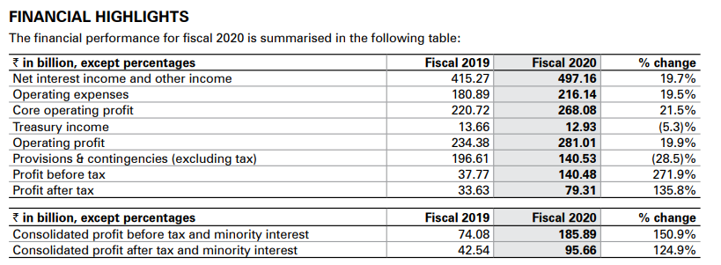
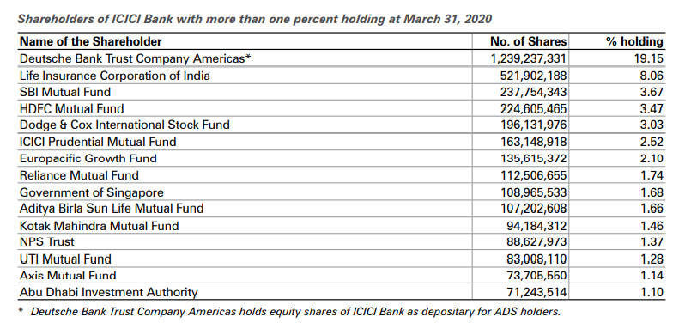
Financial Performance

Slide 5
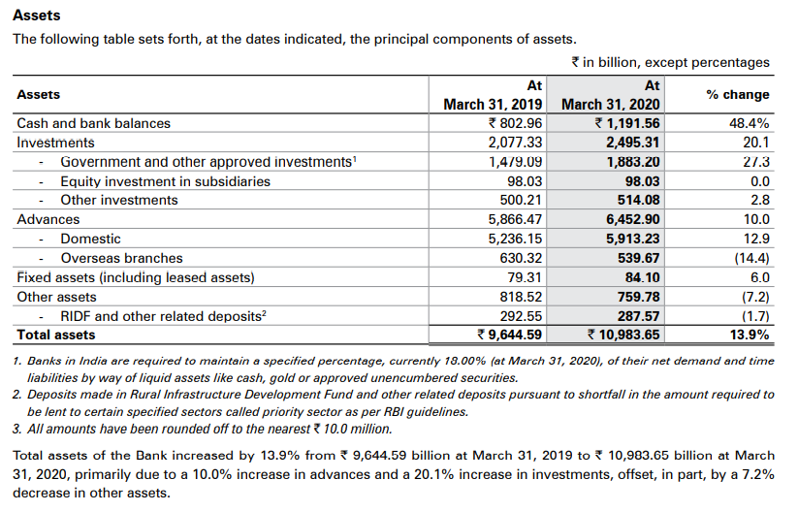
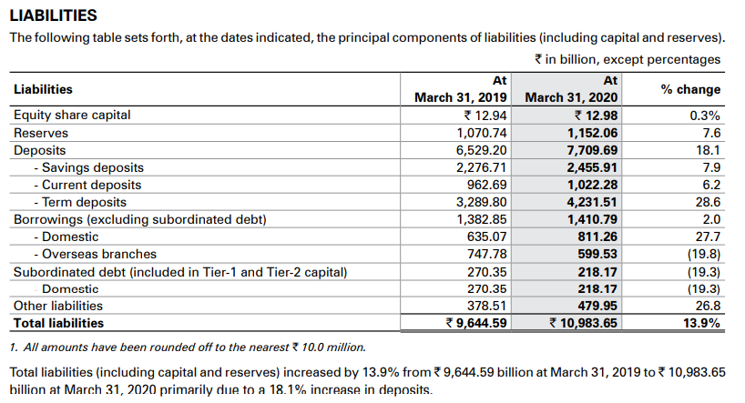

Slide 6
Time Series Analysis

Slide 7
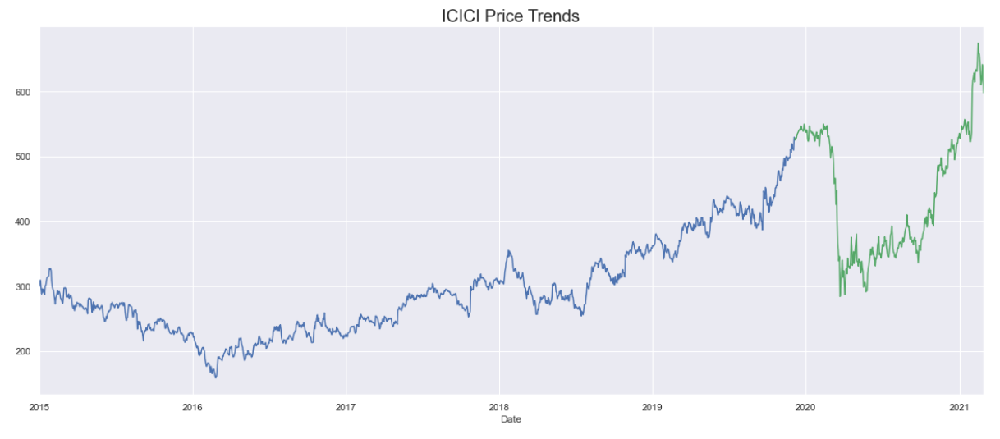
Price Trends

Slide 8
Time Series Analysis
Time series analysis is a statistical method to analyse the past data within a given duration of time to forecast the future. It comprises of ordered sequence of data at equally spaced interval.
$$Time Series =Trend+Seasonality+Residual$$

Slide 9
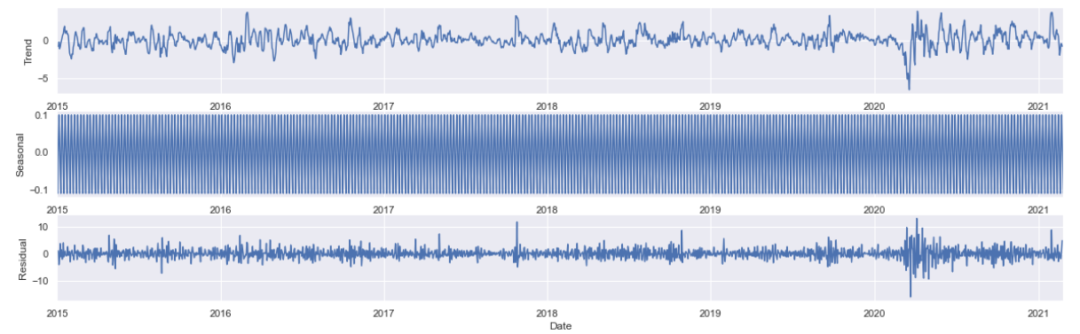
Seasonality

Slide 10
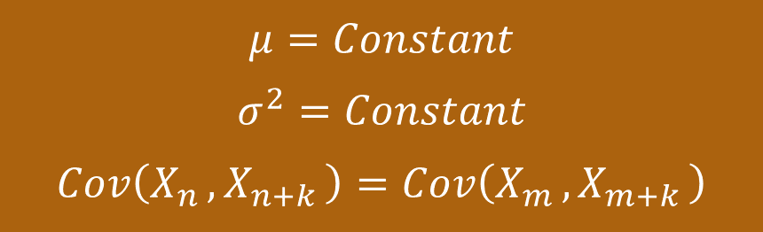
Stationarity
$$μ=Constant$$
$$σ^{2}=Constant$$
$$Cov\left(X_{n },X_{n+k }\right)=Cov\left(X_{m },X_{m+k }\right)$$

Slide 11
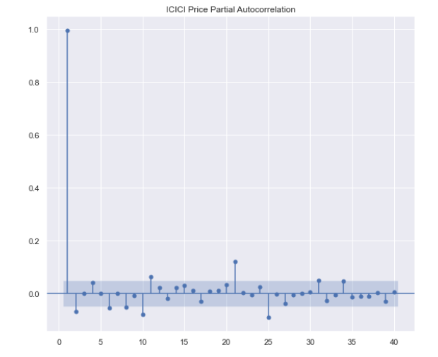
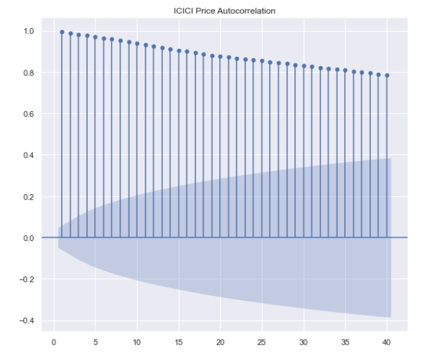
PACF & ACF for Prices

Slide 12
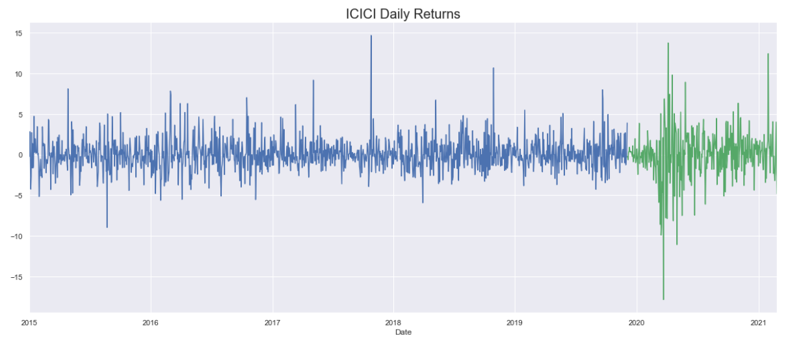
Returns

Slide 13
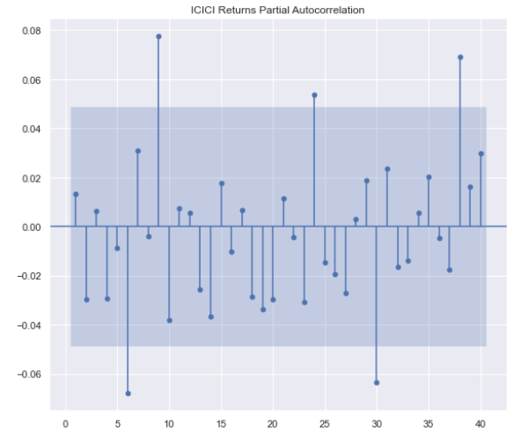
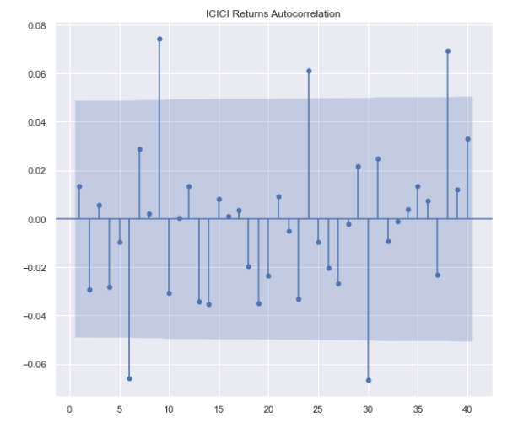
PACF & ACF for Returns

Slide 14
ARIMA
Non-stationary Time series

Slide 15
ARIMA
$$y_{t}=c+φ_{1}y_{t−1}+…+φ_{p}y_{t−p}+ε_{t}+θ_{1}ε_{t−1}+…+θ_{q}ε_{t−q}$$

Slide 16
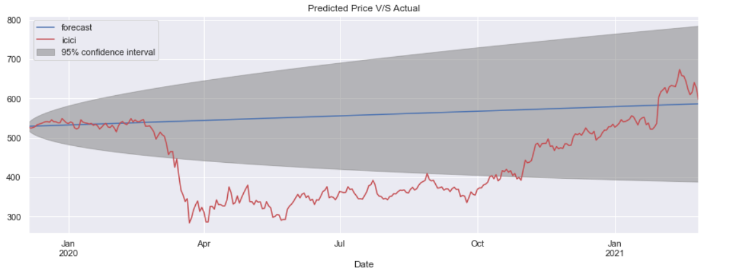
Prediction

Slide 17
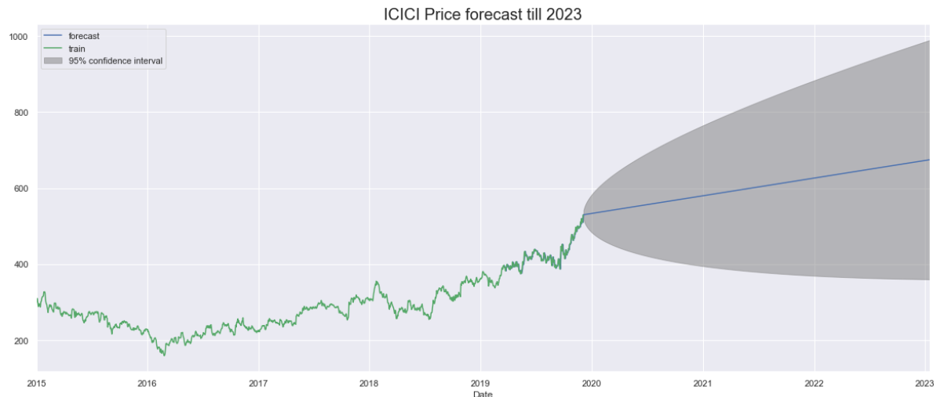
Price Forecast

Slide 18
ARMA
Stationary Time Series

Slide 19
ARMA
$$y_{t}=c+φ_{1}y_{t−1}+…+φ_{p}y_{t−p}+ε_{t}+θ_{1}ε_{t−1}+…+θ_{q}ε_{t−q}$$

Slide 20
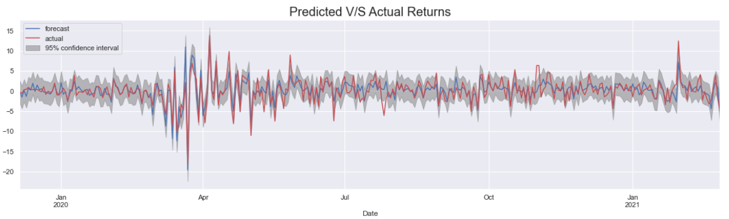
Prediction

Slide 21
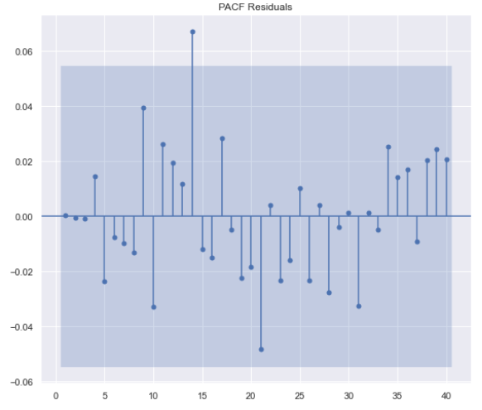
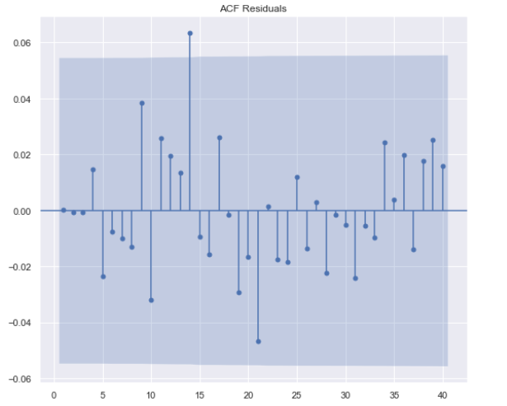
Test for Overfitting

Slide 22
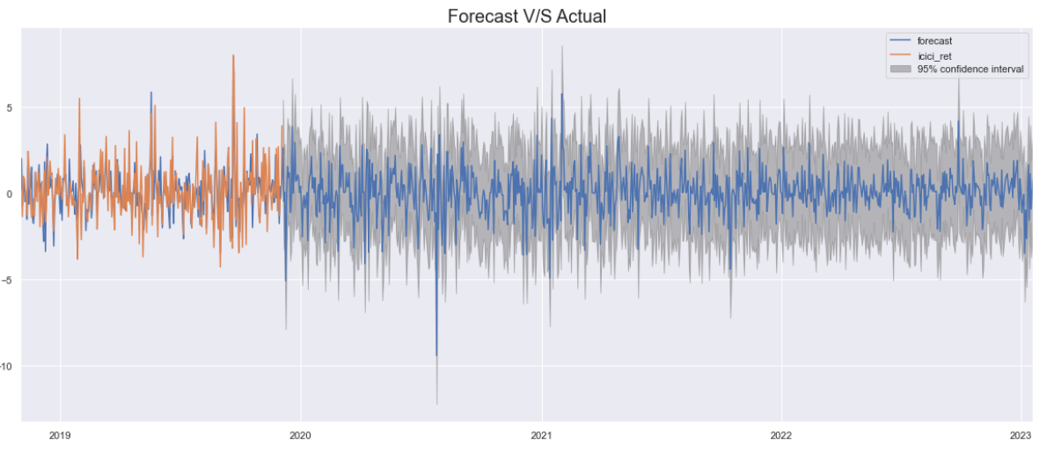
Returns Forecast

Slide 23
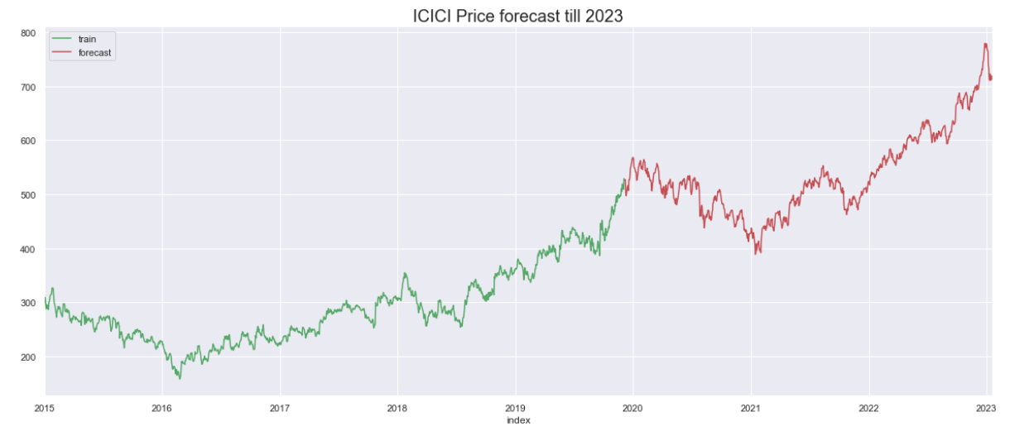
Price Forecast

Slide 24
Comparison

Slide 25
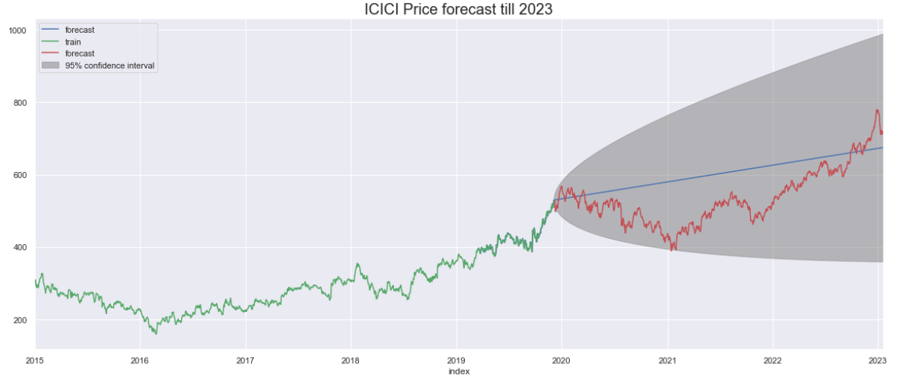
Price Forecast

Slide 26
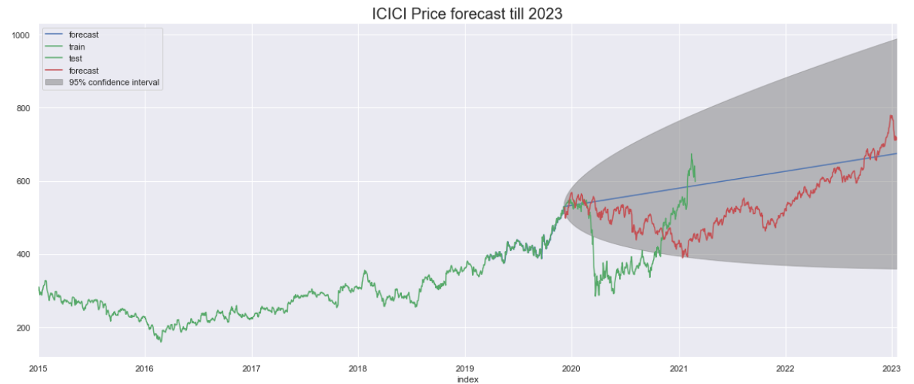
Real Market Scenario

Slide 27
Thank You

